Slide 1
STEM Symposium

Slide 2
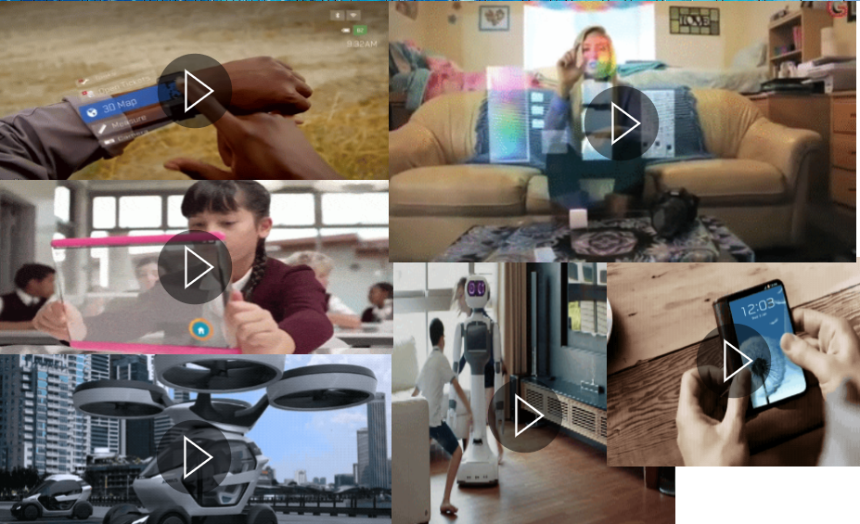
The Future or Now?
Autonomous Vehicles
Robotics
Embedded Technology
Artificial Intelligence

Slide 3
Emerging Industries with Most Impact
Source: CompTIA 1,000 Business Decision Maker Report 2018

Slide 4
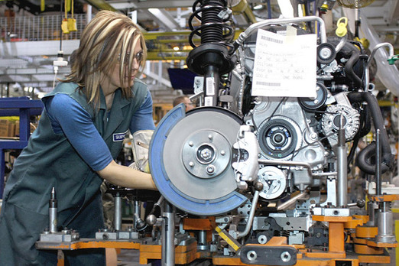
Missouri Industry Strengths
Advanced Manufacturing
IT / Technology
Financial & Professional Services
Construction / Development
Agriculture and Bio-Lifesciences
Health Care
Transportation Logistics
Source: MERIC Industry Clusters

Slide 5
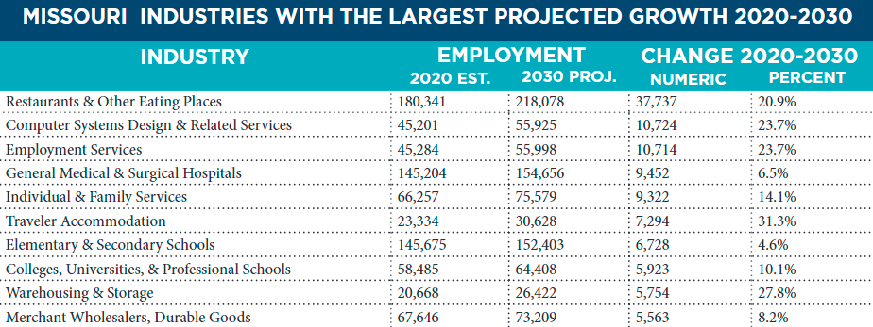
IT Technology Missouri Ranks
Source: MERIC – 2022 Missouri Economic & Workforce Report
Notes:
https://meric.mo.gov/media/pdf/missouri-economic-and-workforce-overview

Slide 6
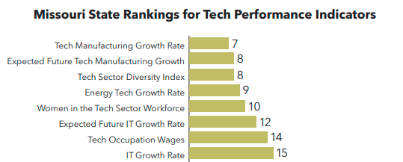
IT Technology Missouri Ranks
Source: Missouri Chamber Foundation - Missouri 2030 Technology Report
Notes:
Source: State of St. Louis Workforce
http://www.stlcc.edu/Workforce-Solutions/St-Louis-Workforce/

Slide 7
IT Technology Missouri Ranks
Source: Missouri Chamber Foundation - Missouri 2030 Technology Report
Notes:
Source: State of St. Louis Workforce
http://www.stlcc.edu/Workforce-Solutions/St-Louis-Workforce/

Slide 8
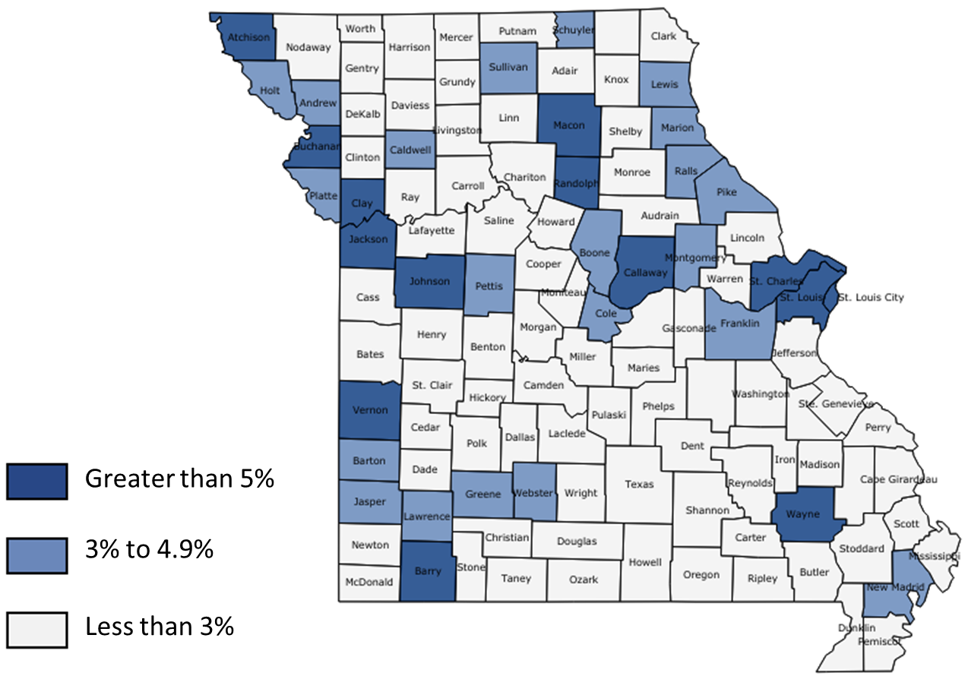
Total Tech Jobs of All Jobs 2017
Source: Missouri Chamber Foundation - Missouri 2030 Technology Report

Slide 9
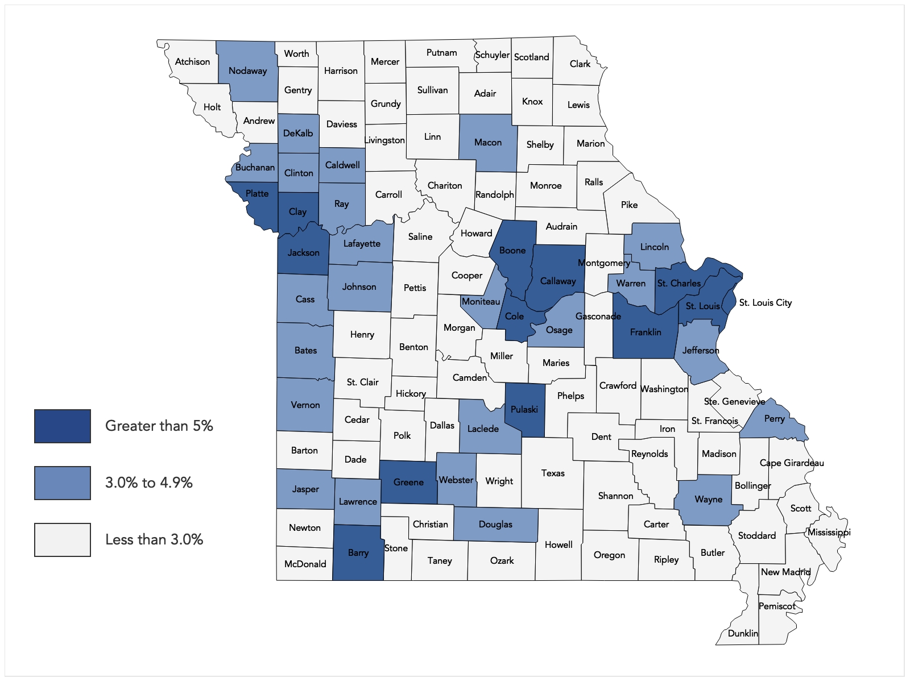
Total Tech Workers Per Workforce 2017
Source: Missouri Chamber Foundation - Missouri 2030 Technology Report

Slide 10
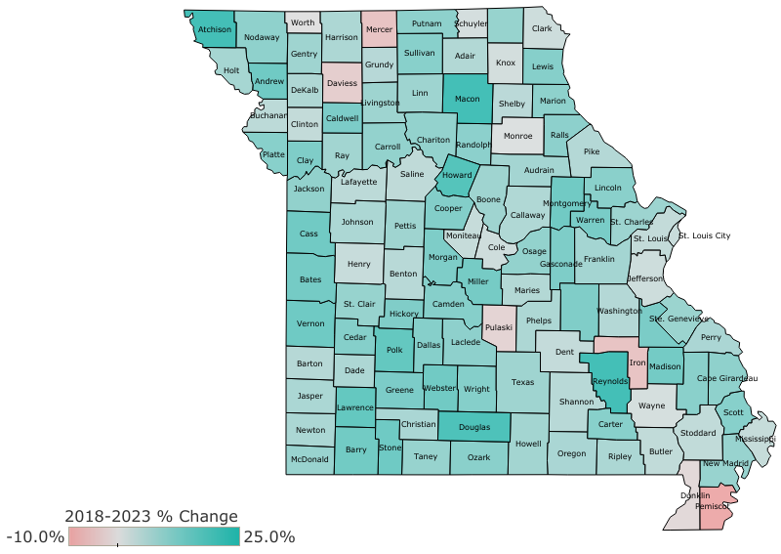
Projected Tech Occupation Growth 2018-2023
Source: Missouri Chamber Foundation - Missouri 2030 Technology Report

Slide 11
Regardless of Industry, Tech Drives Missouri…
Source: Missouri Chamber Foundation Math and Science Coalition

Slide 12
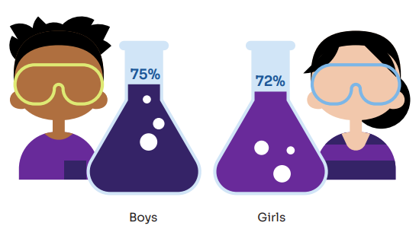
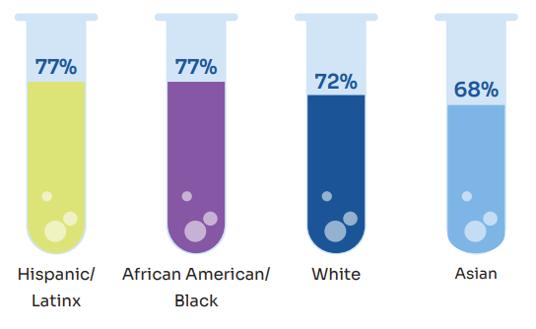
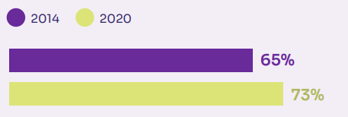
STEM in the Afterschool
Parents reporting that their Afterschool program offers STEM
STEM in Afterschool reaches all students
Parents value STEM in Afterschool
Source: Afterschool Alliance 4th Edition America After 3pm Report
Notes:
The 2020 America After 3PM survey was the first time that computer science was included as an option for parents to select when identifying different options of STEM activities in their child’s afterschool program.

Slide 13
STEM in the Afterschool
Parents reporting that their Afterschool program offers STEM
STEM in Afterschool reaches all students
Parents value STEM in Afterschool
Source: Afterschool Alliance 4th Edition America After 3pm Report
Notes:
The 2020 America After 3PM survey was the first time that computer science was included as an option for parents to select when identifying different options of STEM activities in their child’s afterschool program.

Slide 14
STEM in the Afterschool
Source: Afterschool Alliance 4th Edition America After 3pm Report
Notes:
The 2020 America After 3PM survey was the first time that computer science was included as an option for parents to select when identifying different options of STEM activities in their child’s afterschool program.

Slide 15
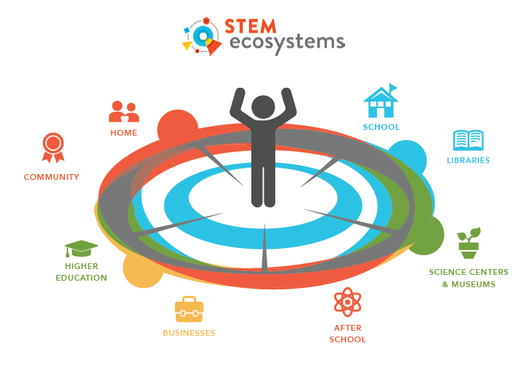
STEM Ecosystems
Source: Afterschool Alliance 4th Edition America After 3pm Report
Notes:
The 2020 America After 3PM survey was the first time that computer science was included as an option for parents to select when identifying different options of STEM activities in their child’s afterschool program.

Slide 16
Pushing start on 2023 Goals
Start with a vision
Develop a plan that is detailed and executable
Create sustainability, stakeholder buy-in and awareness
Consistently deliver, with Key Performance Indicators (KPI) to measure impact and progress
Reflect, report and evolve

Slide 17
STEM Symposium

